Slide 1
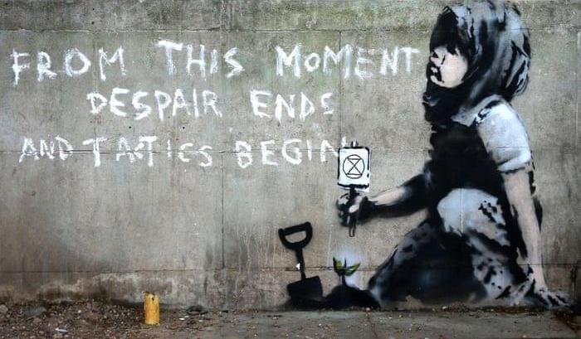
Teil 2
WAS JETZT?
Notes:
[5 second pause for reading]

Slide 2


Hoffnung stirbt
Handeln beginnt

Slide 3


Die pflicht zu handeln
Wir sind die letzte Generation, die die Katastrophe noch aufhalten kann.
Was sage ich einmal meinen Kindern / Enkelkindern?
Notes:
[From transcript] “So we need to take a new approach.”

Slide 4
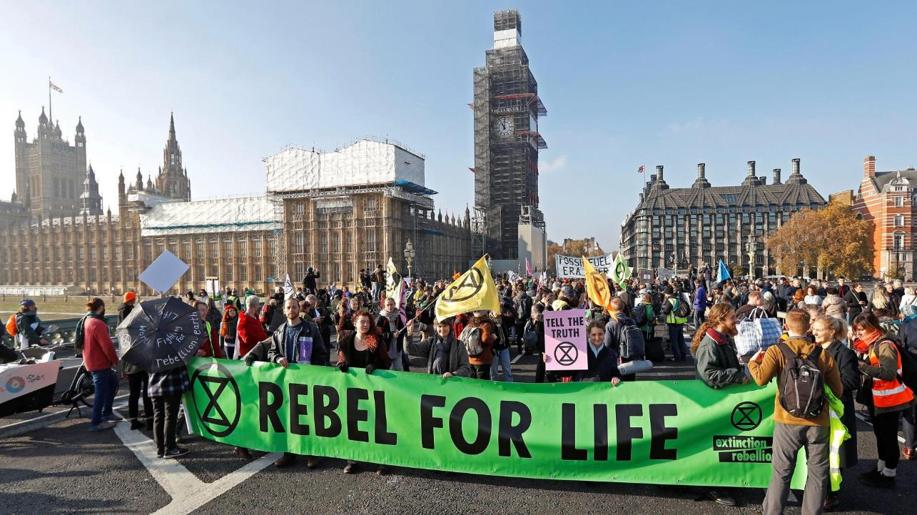
Extinction rebellion
Seit 2018 als Teil von Rising Up
Deklaration der Rebellion im Oktober 2018
Londoner Brückenblockaden
Seit Jänner 2019 in Wien, seit August 2019 in Graz
Notes:
[From transcript] “So… introducing Extinction Rebellion! This is an organisation that popped up seemingly out of nowhere and it came to public notice last year, shortly after the very very hot summer we had just had, and shortly after the IPCC report that had just said we have ten years or twelve years or whatever to take action or it may be too late. They really hit the headlines with a protest in which they blocked several of the major bridges in London and got themselves all over the news and reached the attention of many of us (including myself). They seemed to be offering something that nobody else was offering in terms of climate action. And so a lot of people became very interested in what they’re doing and their profile really rose rapidly.”

Slide 5
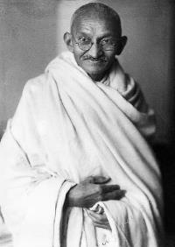
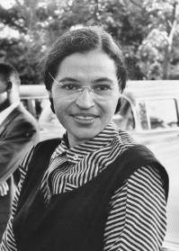
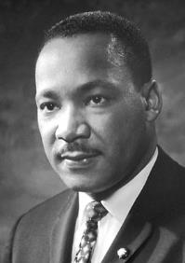

Gewaltfreier ziviler ungehorsam
Mahatma Gandhi
Rosa Parks
Martin Luther King
Notes:
Instead, we need to flout the rules – make new ones.
Civil resistance, also called disobedience on non-violent direction action (NVDA – Extinction rebellion’s preferred term) means that normally law-abiding citizens start breaking rules and laws as a way to force change in a system that is refusing to change.
It has been used successfully many times in the past, notably by Gandhi who organized Indian rebellion against British rule, Rosa Parks who famously refused to give up her seat on a bus to a white person and triggered the American Civil Rights movement, and Martin Luther King who organized the movement and mobilized huge numbers of Americans to force changes to racially discriminatory laws.
These people are regarded as heroes now, but at the time were often vilified for their law-breaking and disruptiveness.
[From transcript] “Now there’s actually a long and honourable history of moral people who have flouted the rules. This is called “civil resistance” or “civil disobedience” – the word that we use in Extinction Rebellion is “Non-violent direct action” and what that means is direct action by citizens who are trying to get change made by breaking rules and getting attention. And there have been some extremely famous and effective examples of civil resistance – Mahatma Gandhi, Rosa Parks and Martin Luther King are all political figures who have had (although they were individuals) they have managed to spawn movements that have transformed the society that they were in. So it’s possible for individuals to motivate collective change by resistance – resistance against authority.”

Slide 6
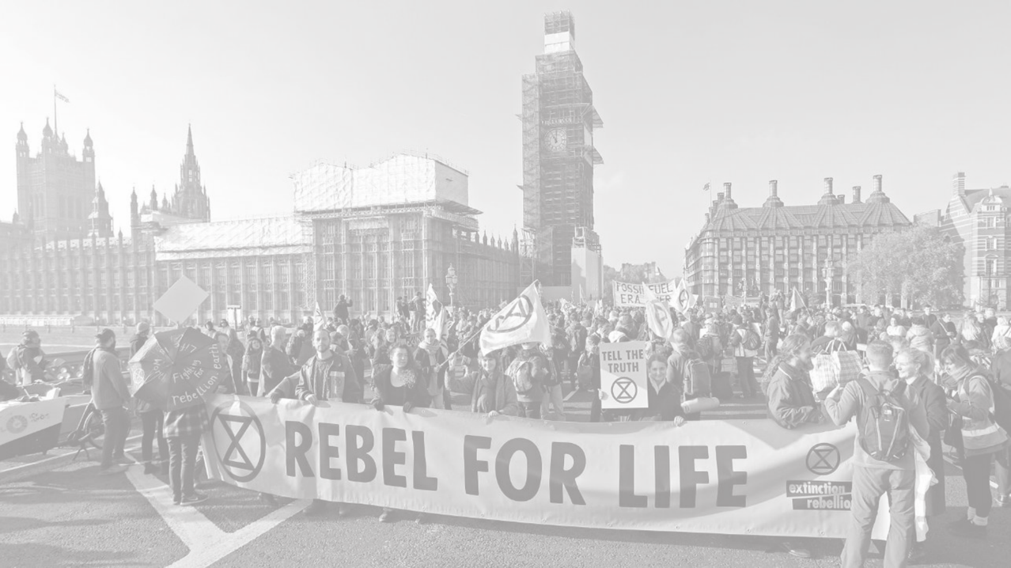

Stören, um gehört zu werden
Gewaltfreier ziviler Ungehorsam …
ist ein historisch bewährtes Mittel, um Veränderungen herbeizuführen
hat höhere Erfolgschancen als gewaltsame Aufstände
erfordert nur 3,5% der Bevölkerung, die sich daran beteiligen müssen

Slide 7
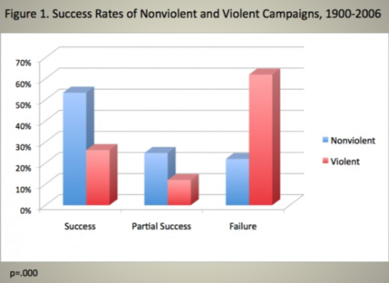

Gewaltfrei vs gewaltsam
Chenoweth et al., 2017

Slide 8
Die klassische vorstellung
Konfrontation: schockierende Daten & Fakten
Zahl der Menschen
“gleichgültig”
“voll engagiert”
“etwas besorgt”
Engagement

Slide 9
Unsere Vorstellung
Konfrontation: schockierende Daten & Fakten
Zahl der Menschen
“apathisch”
“voll engagiert”
“etwas besorgt”
Engagement

Slide 10

Unsere drei
forderungen
Notes:
[From transcript] “So what do we want? We have three basic demands.
The first is for the authorities – the government and the media – to tell the truth about the ecological crisis. There’s been a tendency to water down the problem. For example, for a long time the climate problem was presented as a scientific debate – so the BBC, when it had a climate scientist on, for example, to be interviewed, would have a climate-change sceptic to speak with the climate scientist in the interests of presenting “both sides” – as if there were a debate about climate change, when there hasn’t been a debate about climate change. Science is unanimous in its view that climate change is happening and it’s happening fast and it needs to be stopped. So we need to stop this false balance – we need people to be told what’s happening. It’s a really difficult truth, as you’ve heard – it’s not nice, it doesn’t make you feel good. People don’t like to be told things that don’t make them feel good. But they’re not going to act if they don’t know what’s going on.
The second thing is – we want the industrialised nations, including our own, to stop emitting greenhouse gases, and Extinction Rebellion has set a target for 2025 for this – to zero our emissions. Even if we zero our emissions – even if we did that tomorrow – we have at present 415 parts per million carbon dioxide in the atmosphere – we’re supposed to have 280 parts per million so even if we stopped our emissions we are going to continue warming for some unforeseeable amount of time until that excess carbon dioxide is taken up again. We need to stop immediately.
And then the third demand is for a Citizens’ Assembly on climate and ecological justice – I’ll talk more about that in a moment.”

Slide 11


1. Die wahrheit sagen

Slide 12
Die Regierung muss…
die Fakten zu Klimakrise und ökologischem Kollaps endlich anerkennen.
alle Gesetze aufheben und alle Projekte stoppen, die zu deren Verschlimmerung beitragen.
die Bevölkerung sofort über die tödliche Bedrohung informieren.

Slide 13

2. Netto null bis 2025
Notes:
[From transcript] “The second thing that’s really important about it is that it’s de-centralised. It’s not a central organisation with a headquarters as such (although there is a notional loose headquarters for coordination purposes) but essentially, the way it works is that provided a person is willing to sign up to the principles of Extinction Rebellion, which are laid out in its website (I’m not going to go through them in detail but the principles are basically to do with justice and fairness and all this type of stuff) – provided you’re willing to adhere to those principles and to support the three demands, anybody can act in the name of Extinction Rebellion.”

Slide 14





Unmöglich? Nicht im Krieg!
Warum nicht auch für unser überleben?
Notes:
gEOTECHMOLOGIE

Slide 15
3. Bürger*innen-
versammlungen

Slide 16
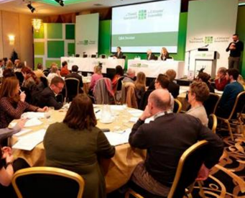
Bürer*innenversammlungen
sind ein Mittel der partizipativen Demokratie
werden nach dem Losverfahren zusammengestellt
Personen erhalten umfassende Beratung von Expert*innen

Slide 17






Das konzept in der praxis
Formulierung von Vorschlägen und Abstimmung
zufällige
Auswahl
Input aus der Bevölkerung
Beratung durch Expert_innen
Moderierte Diskussion in Kleingruppen

Slide 18
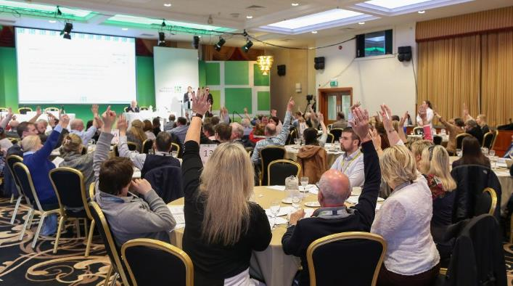

Das konzept in der praxis
Erfolge der irischen Citizens’ Assembly:
Verfassungsreform
Abtreibungsrecht

Slide 19


Werte & prinzipien
WIR HABEN EINE GEMEINSAME VISION DER VERÄNDERUNG
UNSER FOKUS LIEGT AUF DEM ERREICHEN DES NOTWENDIGEN
WIR BRAUCHEN EINE REGENERATIONSKULTUR
WIR FORDERN UNS SELBST UND DAS TOXISCHE SYSTEM OFFEN HERAUS
WIR LEGEN WERT AUF REFLEXION UND ENTWICKLUNG
ALLE SIND WILLKOMMEN – SO WIE SIE SIND
WIR STELLEN MACHTSTRUKTUREN IN FRAGE
WIR VERMEIDEN ANSCHULDIGUNG UND BELEIDIGUNG
WIR SIND EINE GEWALTFREIE BEWEGUNG
WIR BASIEREN AUF AUTONOMIE UND DEZENTRALITÄT

Slide 20


Wir sind dezentral
Und
selbstorganisiert
Notes:
[From transcript] “The second thing that’s really important about it is that it’s de-centralised. It’s not a central organisation with a headquarters as such (although there is a notional loose headquarters for coordination purposes) but essentially, the way it works is that provided a person is willing to sign up to the principles of Extinction Rebellion, which are laid out in its website (I’m not going to go through them in detail but the principles are basically to do with justice and fairness and all this type of stuff) – provided you’re willing to adhere to those principles and to support the three demands, anybody can act in the name of Extinction Rebellion.”

Slide 21
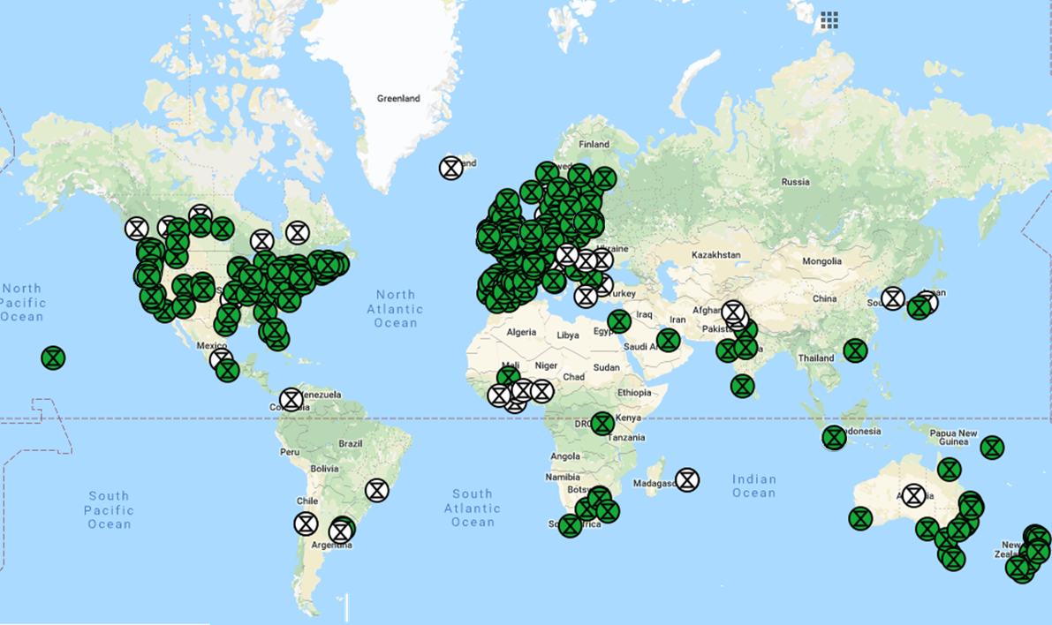

XR Global
Notes:
[From transcript] “Many of us joined up – and indeed many people across the planet joined up. The organisation, although it started locally has spread now cross the planet and every day, new groups spring up all over the place – mostly in the UK, Europe and the US but also spreading to other places quite rapidly now.”

Slide 22
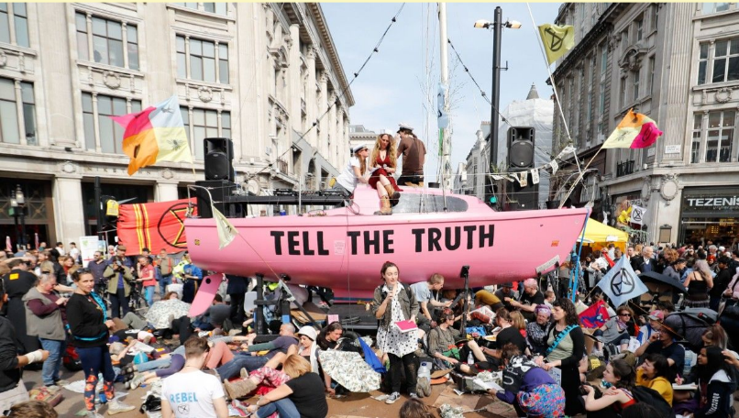
Was wir tun - impressionen

Slide 23
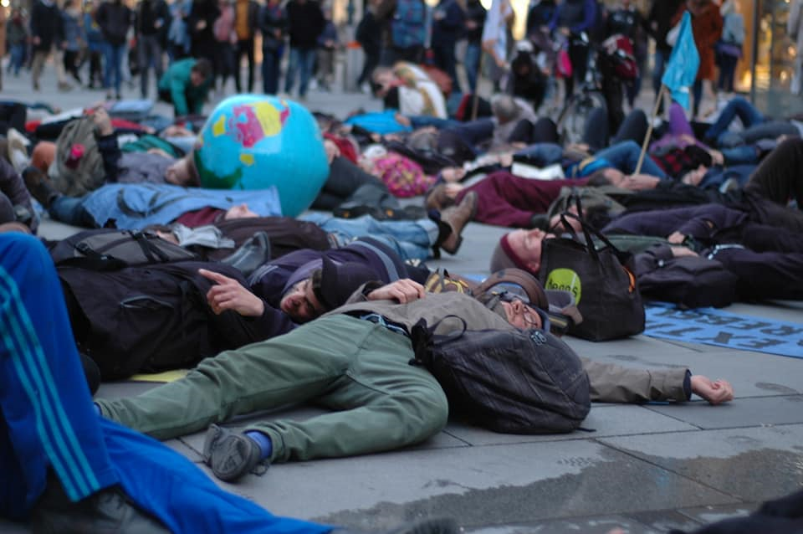
Die-ins

Slide 24
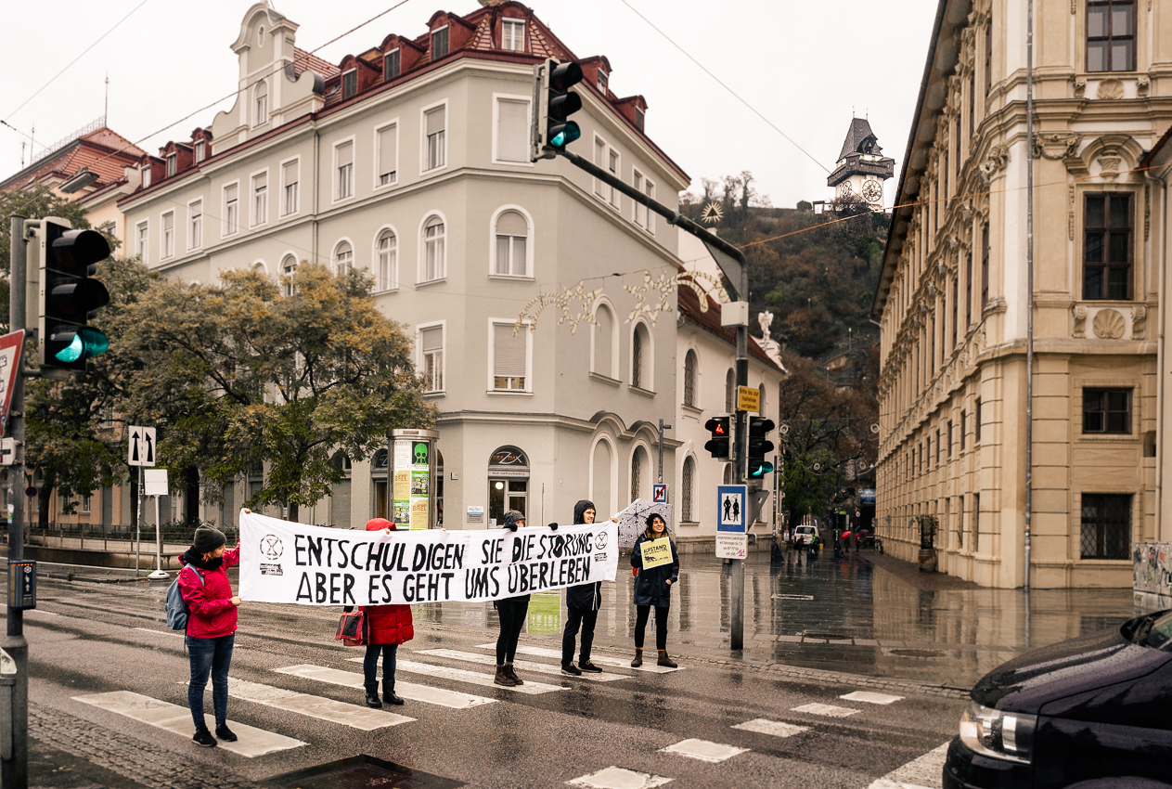
swarmings

Slide 25
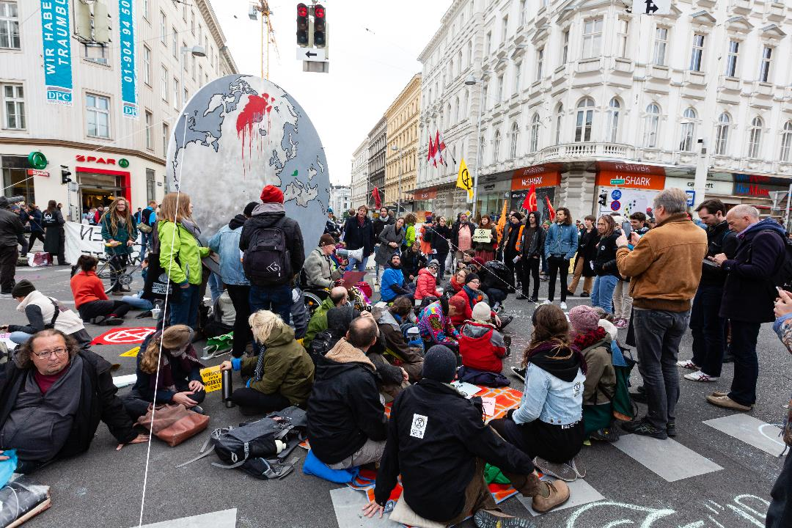
sitzblockaden

Slide 26
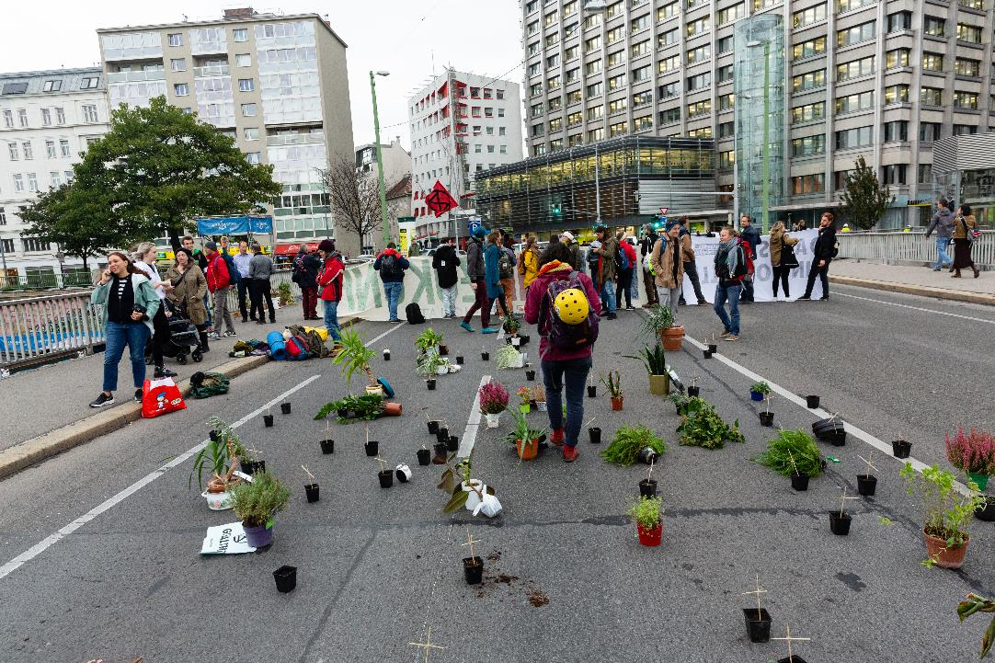
Brückenblockaden

Slide 27

trauermÄrschE

Slide 28
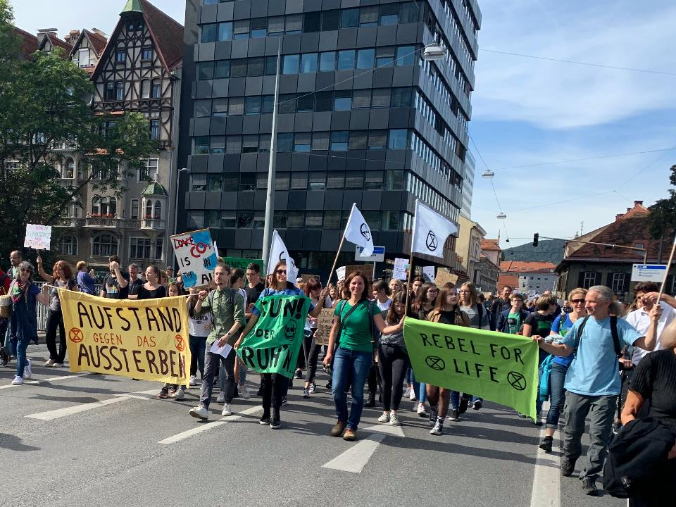
Demos

Slide 29
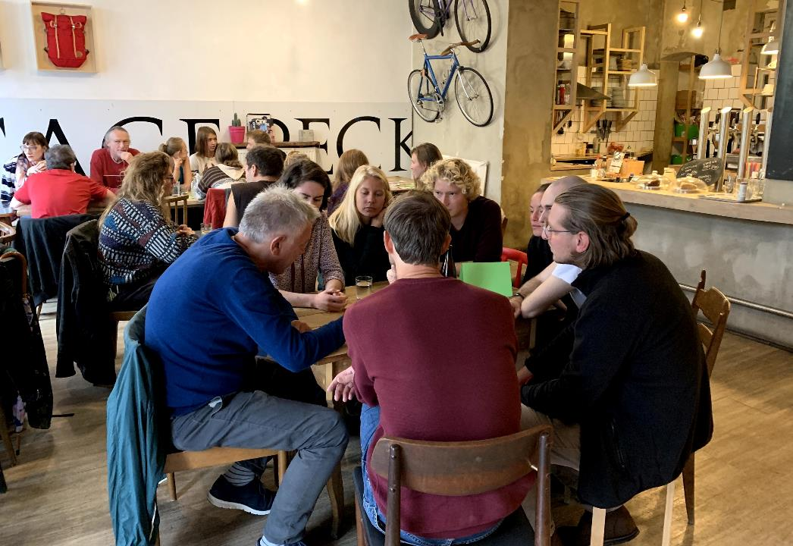
Xr-cafes

Slide 30
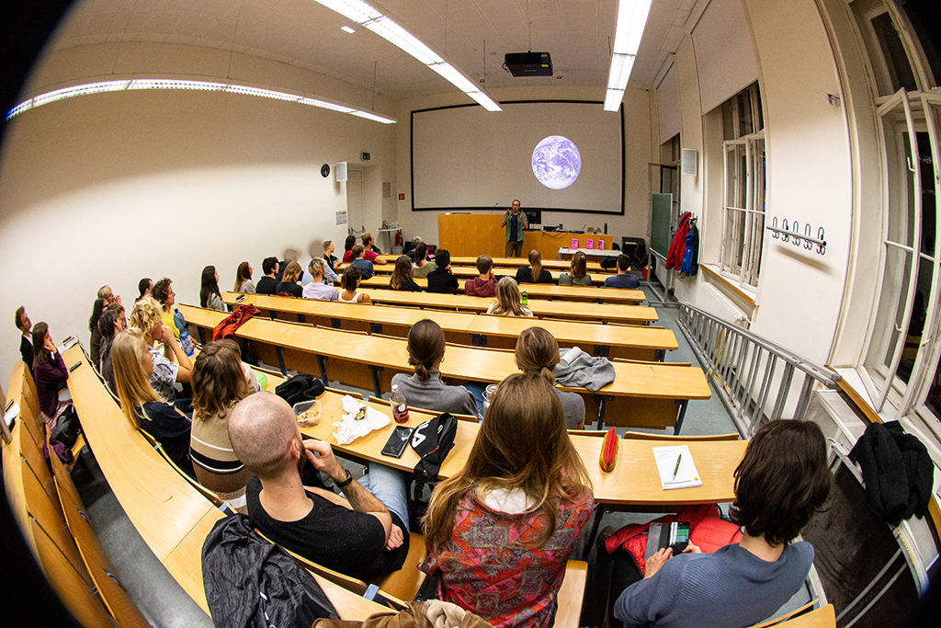
TALKS

Slide 31
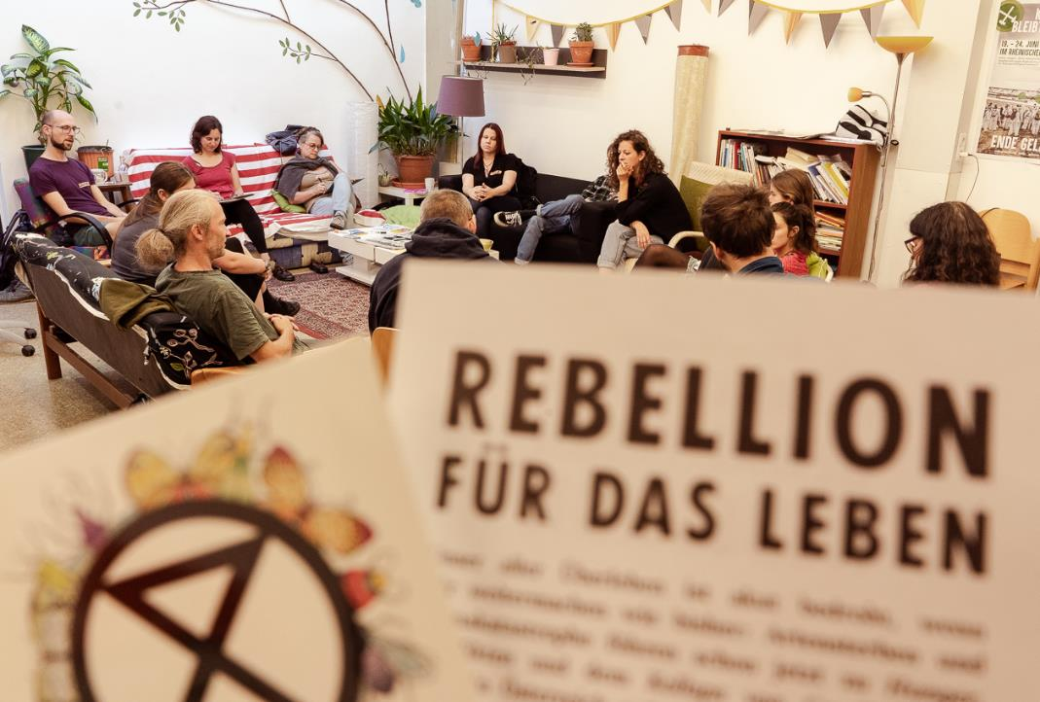
Workshops & Trainings

Slide 32

Beteiligung
Organisation
Koordination
indirekte Hilfe
Mitmachen bei Aktionen

Slide 33

Zum weiterlesen

Slide 34
NÄCHSTE tERMINe
XR-Onboarding: 14. Jänner 2020, 18:30 – 20:30 Uhr
im Schubertnest, Harrachgasse 21, 8010 Graz
-------------------------------------------------
XR-Café: 21. Jänner 2020, 19:00 – 21:00 Uhr im Café Erde, Andreas-Hofer-Platz 3, 8010 Graz

Slide 35


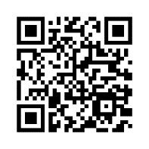
Kontakt & infos
E-MAIL XR-GRAZ@POSTEO.AT
FACEBOOK ExtinctionRebellionGraz
INSTAGRAM extinctionrebellion_graz
TWITTER @XRGraz
WEBSITE http://xrebellion.at/
Notes:
[From transcript] “So, just to finish with this… you don’t need permission to get involved with the organisation – you can visit the website… if you’ve got your phone on you you can just take a photo [of the QR code] and it’ll take you right there. You can find out who’s local to you or you could join a London group or you could start a UCL group or just do whatever… even just speak positively about us to your friends when they’re moaning about the disruption that we cause! Anything that you can do would be very helpful.”

Slide 37
Weitere Ergebnisse in Irland
Verkauf von erneuerbarer Energie an das Netz erlauben
Ausbau von Busspuren, Radwegen, Park&Ride
klimaschädliche Aktivitäten höher besteuern
97%
89%
80%
99%
93%
Streichung aller Förderungen für den Torfabbau
Besteuerung von Emissionen aus der Landwirtschaft

Slide 38
Werte und Prinzipien
Gemeinsam erschaffen wir Strukturen, in denen Alle willkommen sind – so wie sie sind.
Wir gleichen das Gefälle von Macht und Einfluss aktiv aus, um eine gerechte Teilhabe zu ermöglichen.
Alle, die unseren Prinzipien und Werten folgen und unsere Forderungen teilen, können als Extinction Rebellion in Aktion treten.

Slide 39
Du veränderst nichts,
indem du die bestehende realität bekämpfst.
Um etwas zu ändern,
baue ein neues modell,
das das bestehende überflüssig macht.
Buckminster Fuller
Notes:
[From transcript] “So we need to take a new approach.”

